Slide 1
Android Environment for SLAM SW Development
TEL AVIV UNIVERSITY
The Iby and Aladar Fleischman Faculty of Engineering
The Zandman-Slaner School of Graduate Studies
Ran Attias - 027214733
February 2021

Slide 2
Abstract
Simultaneous Localization And Mapping (SLAM) algorithms are widely used in robot operating system (ROS), MATLAB but are less accessible as open source in Android operating system (OS).
Implementing SLAM on Android OS requires understanding the embedded hardware and the available sensors suit, software drivers (accelerators), computation libraries, and application layer (GUI) coding.
This project aims to explore optional environments and SW frameworks that can be used for SLAM development and integration into Android systems

Slide 3
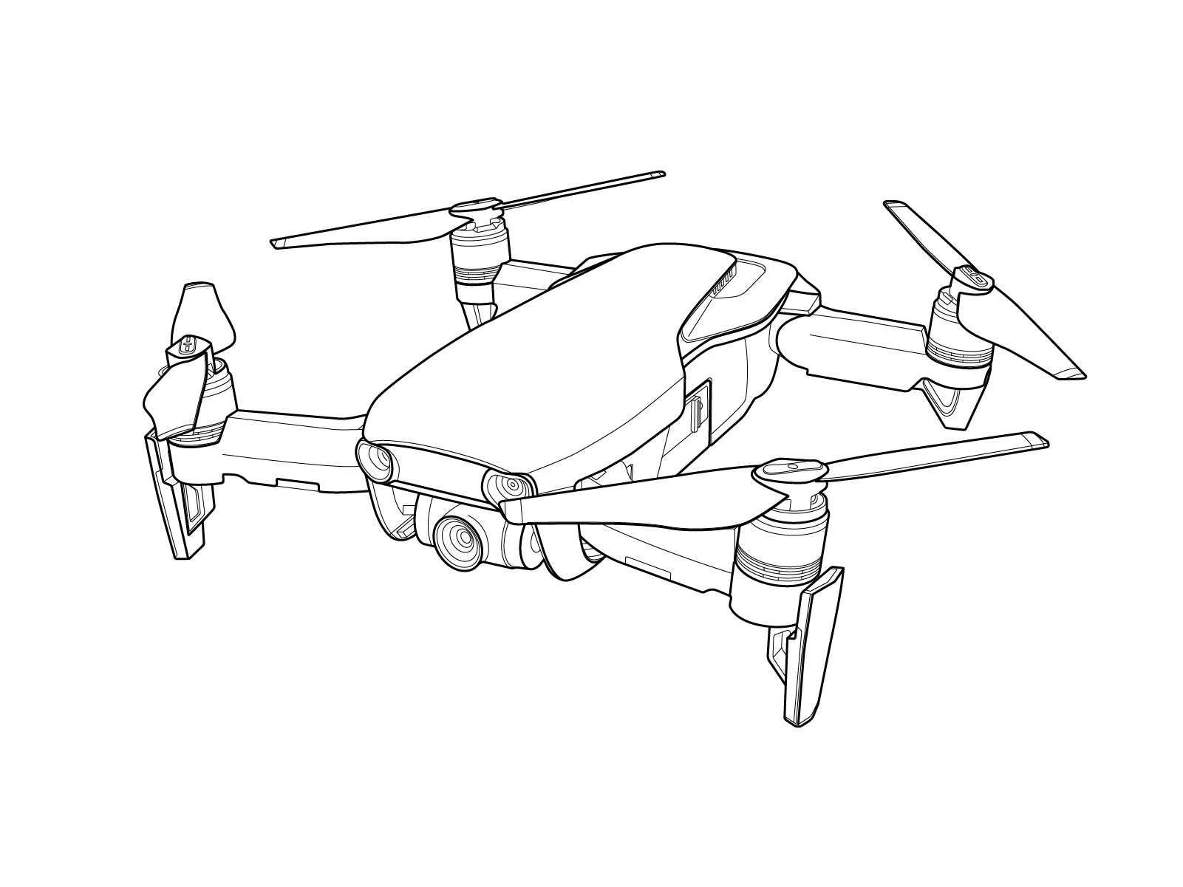
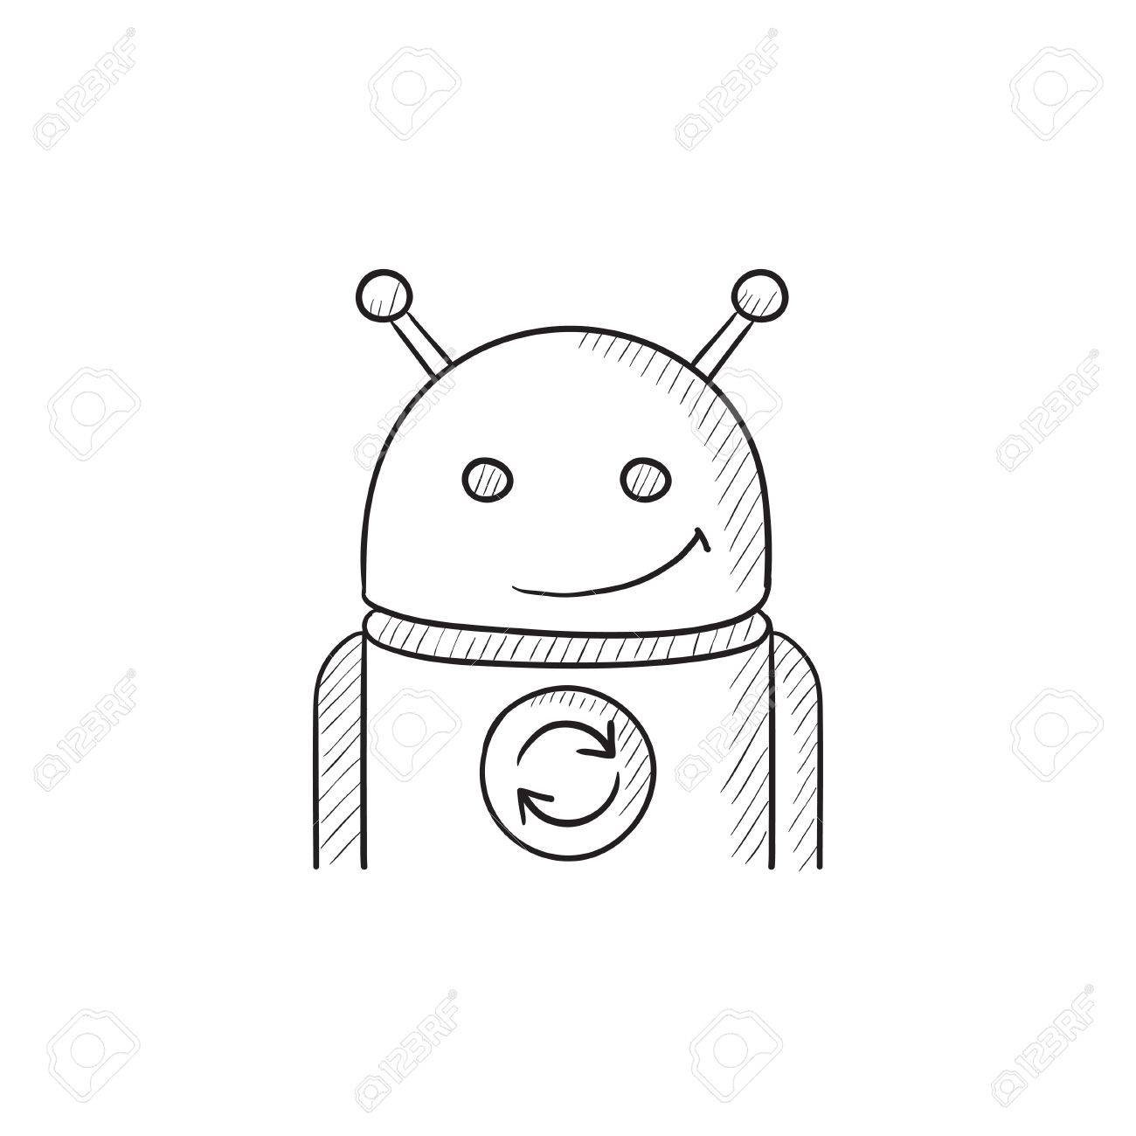
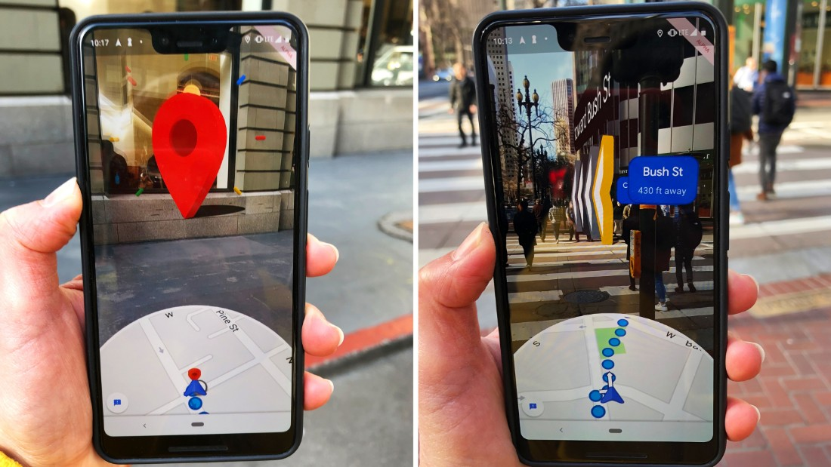
Introduction Project use-case
Android Device
Display
WiFi
SLAM
Algorithm
Google Maps using SLAM for AR overlay

Slide 4
Hardware Selection
Criteria | Google Pixels 4 | Snapdragon 845 Mobile Kit | Snapdragon 845 VR Kit
Cost | $323 | $1079 | Not available
 |  | Display* - $185
 |  | Camera** - $350
Body | Small, case | Open, bulky | Head straps
Camera | Integrated | Plug-in, not included
Qualification | In production | Development | Development
Sensors | accelerometer, gyro, compass, | Not available | 6 DOF, 800Hz
SW | Android 9 | Android 10 | Android 10
Selected HW

Slide 5
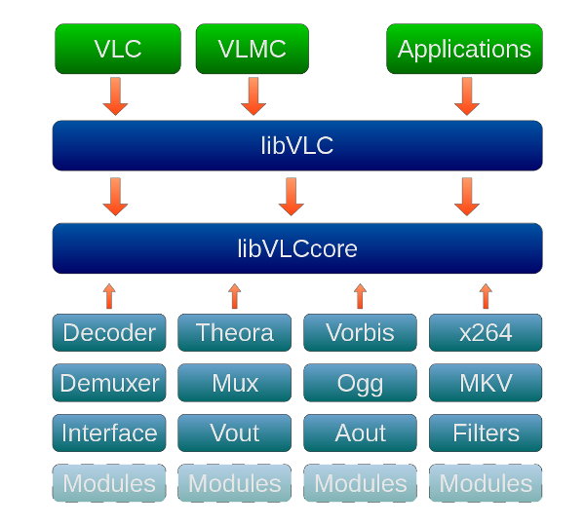
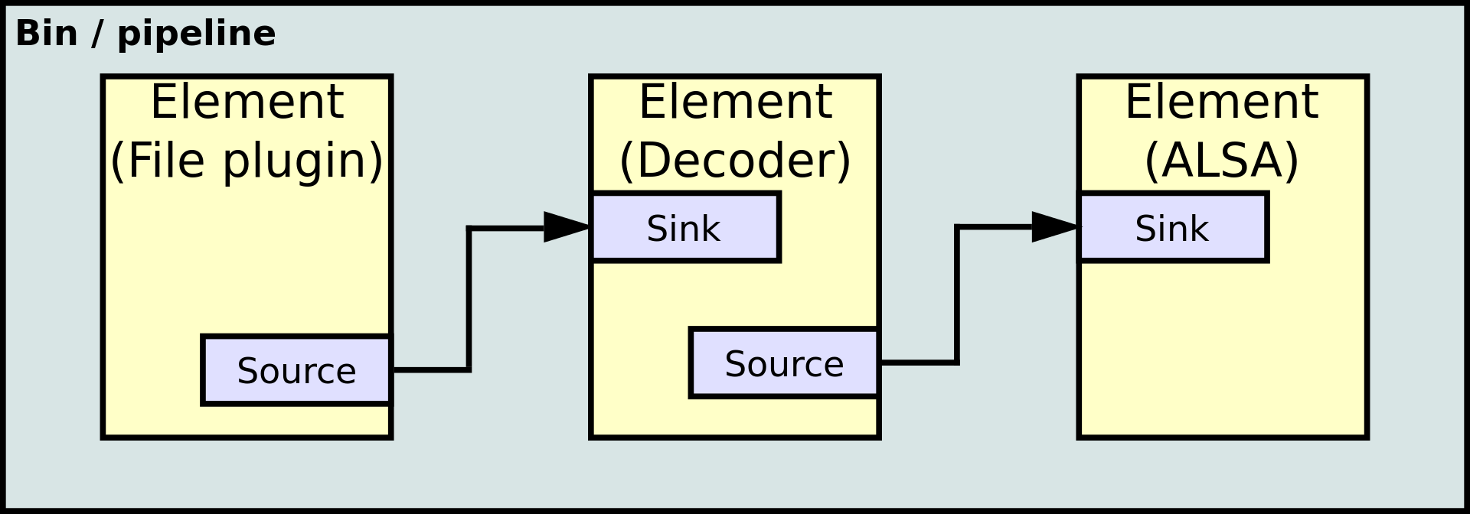
Image Processing Environment and Frameworks
VLC (Video LAN Client)
GStreamer
Open source, a cross platform streaming media player, started as an academic project in 1996.
VLC is a modular framework which allow entertaining new plugins and modules to support new multimedia file formats
multimedia framework uses pipeline structure to support a variety of media processing for both video and audio.

Slide 6
VLC Summary
As VLC is a versatile player with many features and capabilities, which makes it very hard for tweak and change. VLC playback capabilities are way beyond our project needs.
The VLC application was mainly designed for streaming, and not image processing. The VLC application is not running any actual image processing algorithm and was not designed for such.
The GUI application is very complicated and hard to modify

Slide 7
GStreamer Demo
On Linux
Tutorial: https://gstreamer.freedesktop.org/documentation/tutorials/index.html?gi-language=c
On Android
Cross Platform challenge
https://play.google.com/store/apps/details?id=pl.bezzalogowe.udpsink&hl=en&gl=US

Slide 8
GStreamer Summery
The GStreamer can be a good candidate for further investigation, searching for the right way integrating OpenCV libraries into GStreamer under Android. We believe that with knowledge in GStreamer compile and build toolchain, one should be able to create the video pipeline required for our use-case.

